Slide 1

PREDICTING THE ENERGY OUTPUT OF WIND TURBINE BASED ON WEATHER CONDITION USING IBM CLOUD
PRESENTATED BY :
TEAM NO:0008
18UK1A0510 – C.VENU
18UK1A0527 – K.SUCHITHA
18UK1A0539 – N.NAVYA SREE
18UK1A0562 – A.SRUTHI

Slide 2
PROBLEM STATEMENT
Wind energy forecasting plays an important role in wind energy utilization , which is a vital component of wind energy management . In power systems, balance is maintained by continuously adjusting generation capacity and by controlling demand. As wind is a dynamically changing variable , the whole problem can be taken as a time series forecasting . Short-term forecasts (ranging from 1 h up to 72 h) are useful in power system planning for unit commitment and dispatch, and for electricity trading in certain electricity markets where wind power and storage can be traded or hedged..

Slide 3
OUTLINE:
• INTRODUCTION • LITERATURE SURVEY • THEORITICAL ANALYSIS • EXPERIMENTAL INVESTIGATIONS • FLOWCHART • RESULTS • ADVATNTAGES AND DISADVANTAGES • APPLICATIONS • CONCLUSION • FUTURE • BIBILOGRAPHY

Slide 4
INTRODUCTION
Wind energy plays a major role in providing energy worldwide.
Renewable energies are set to conquer the global energy system faster than any other fuel in history.
A wind farm's energy output depends heavily on the weather conditions present at its site.
A wind performance forecast is an estimation of the production expected of one or more wind turbines.
If the output can indeed be predicted more effectively, the energy providers can more effectively organize the joint development of various energy sources to avoid expensive overproduction.

Slide 5
LITERATURE SURVEY
Global energy demand is increasing, and the use of nuclear power, traditional sources of energy such as coal and oil is either considered unsafe or leads to a large amount of CO2 emission.
One the other hand wind is a natural free energy source.
This is extremely unpredictable, which is a major problem for the incorporation of massive wind power into an energy grid.
Present power production by wind farm is very less than the requirements for solving various problems.
With the improvement of forecasting wind speed and wind direction, it is possible to maximize power production of a wind farm.

Slide 6
PROPOSED SOLUTION
Foremost aim of this project is to track effect of weather data to energy production.
Particularly interested in the correlation of different components that characterize weather conditions such as wind speed, pressure, and temperature.
As per the requirement of time constraints presented an analysis of different time intervals:
One-day measurements in ten-minute intervals.
One-week measurements in ten-minute intervals.
One-month measurements in ten-minute intervals

Slide 7
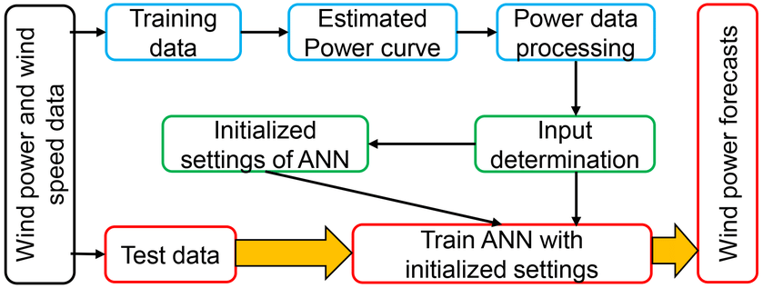
THEORITICAL ANALYSIS: Block diagram

Slide 8
THEORITICAL ANALYSIS: Hardware / Software designing
Type of application: IBM Watson Studio / Jupyter notebook (Anaconda) and Node-RED Operation system: Web frameworks IBM Cloud Watson Studio / Windows 10 .
IDE: Jupyter Notebook
Programing Language: Python 3.8
Dataset: https://www.kaggle.com/berkerisen/wind-turbine-scada dataset.
Libraries Version: numpy 1.15.4, pandas 0.24.1 matplotlib 3.0.2, seaborn -0.9.0, Scikit -learn 0.19.0.

Slide 9
EXPERIMENTAL INVESTIGATIONS
It shows that the accuracy of the current power curve method may depend on the distribution of wind speed, turbulence intensity, and shear at the test site, compared to the deployment site.
If the test site conditions are similar to the deployment site, the power curve
method may give good results.
The regression tree method predicts wind turbine energy capture with two to three times more accuracy than industry standard power curve method , and may be useful for prediction of energy capture at that sites experience different condition than the test site.
To use the regression tree modelling approach to predict the energy capture of a turbine at a new site, several steps are required.

Slide 10
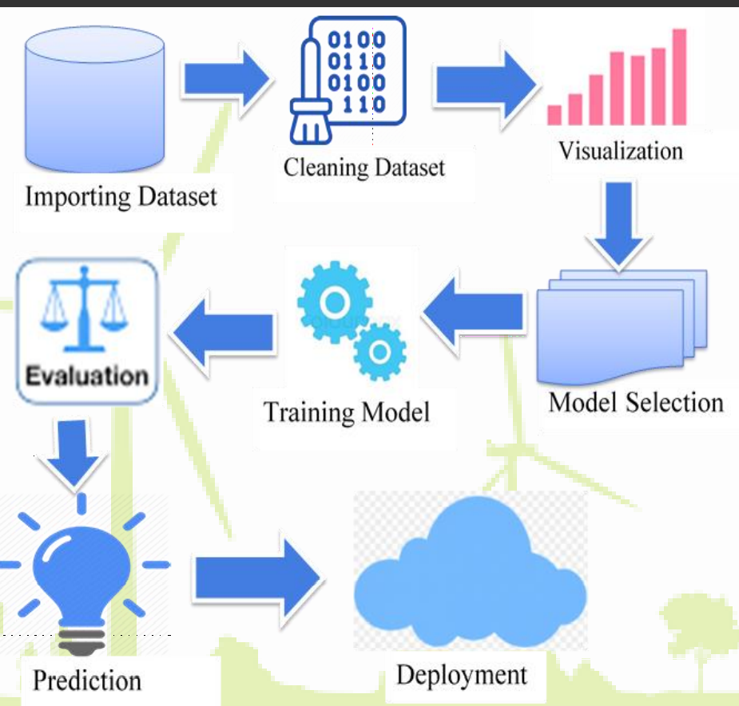
FLOWCHART
Shows the flow of project
modules implementation.
Represents generalized project steps
carried and their synchronization.

Slide 11
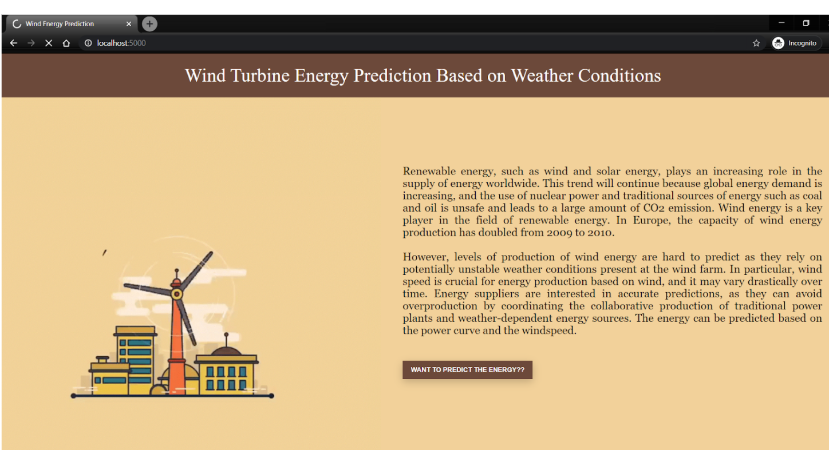
RESULTS

Slide 12
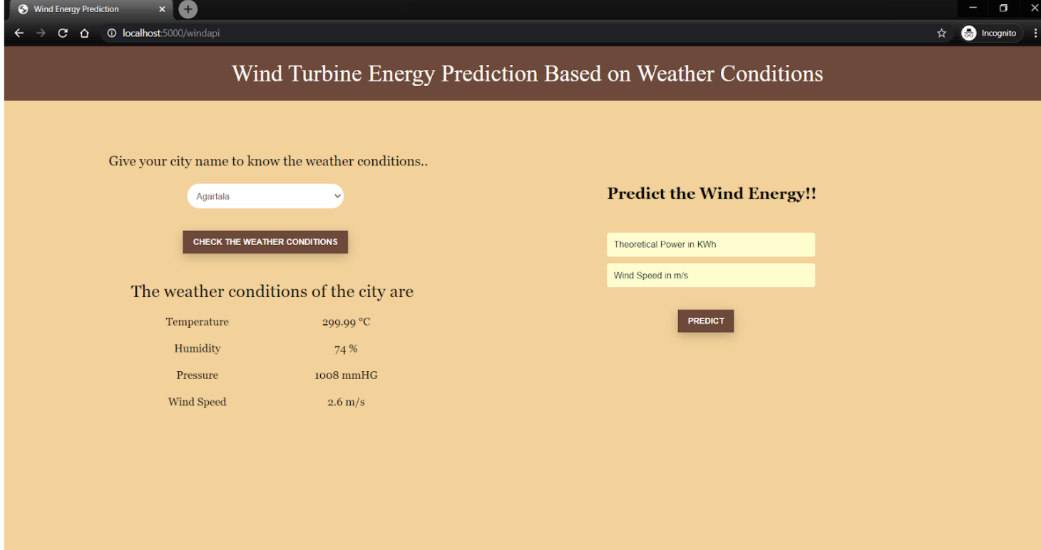
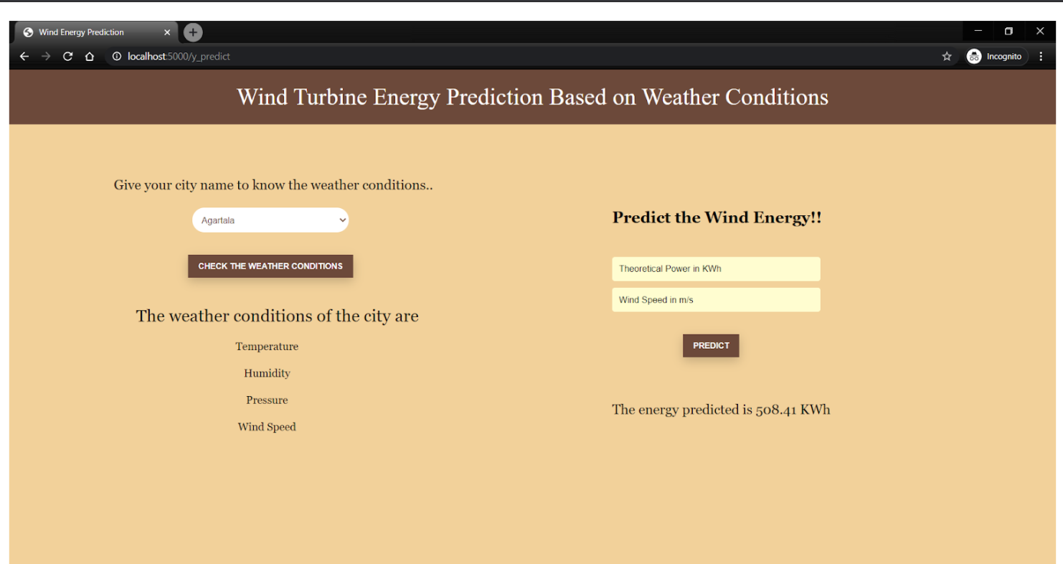
RESULT

Slide 13
Applications
1.The same model mentioned above can also be applied to other data such as Solar energy, tidal energy etc.
2.The model can be transfer-learned for making predictions for other locations, instead of training from scratch. This reduces the time taken for training.
3.The application can also be used as a standalone REST API calls

Slide 14
Advantages and disadvantages
1. Intuitive User Interface
2. Faster Predictions on just a click of a button
3. Accurate predictions Upto- 1 hour to 72 hours
4. 48 predictions per hour for more accurate Power Output visualization
5. The Power grids can make use of this app to efficiently monitor the wind turbine power output.
6. An additional feature : Weather Now, to display the current weather at the location is added to the application.
7. The model is also trained to predict direction of the wind and can be used for the alignment of the turbines.
DISADVANTAGES:
1. On device Deep Learning model cannot be used. The predictions must be made through REST API call to the model.
2. The time taken for predictions is thus compare with little less.
3. The model is trained only on Tamil Nadu , India weather data i.e. Region specific. There is scope for generalizing the model to suit for various other regions.

Slide 15
Conclusion
A Deep Learning model, based on Long Short Term Memory(LSTMs)
has been developed to forecast the Power output of the wind turbine.
A simple, efficient and a versatile model is built keeping in mind the diversity of data, computational complexity and overhead involved in making API calls to the model for prediction.
The product can increase the accuracy of the forecasting the output from the wind turbine .Overall accurate wind power prediction reduces the financial and technical risk of uncertainty of wind power production for all electricity market participants.

Slide 16
Future scope
1. A more generalized model can be developed to suit forecasting for different locations.
2. The model can be developed to make predictions on other sources of data such as solar power, tidal power etc.
3. On-device model can be developed to make much more faster predictions.

Slide 17
BIBILOGRAPHY
[1]. Board, J., & Dashboard, C. P. S. A not-for-profit organization, IEEE is the world’s largest technical professional organization dedicated to advancing technology for the benefit of humanity.
[2]. Chen, N.Qian , Z.Nabney , I. T., & Meng , X. (2013). Wind power forecast.
[3].[Online] https://www.energy.gov/eere/wind/2018-wind-market-reports.
[4]. [Online]
Dataset-Historical Weather API and Kaggle.

Slide 18
THANK YOU

